Slide 1

MIPS Pipeline Simulator
CS3339 spring 2026
By: Jeremiah Medeiros, Josh Boubel, Michael Edwards, Spencer Johnson

Slide 2
Project overview
Instruction-by-instruction simulator for a pipelined MIPS processor
Written in C++, object-oriented programming approach
Includes modules for each microarchitectural element of the processor
follows 5-stage pipeline and respective state registers
Instruction parsing process
Support for separate debug mode
supports the following subset of MIPS instructions

Slide 3
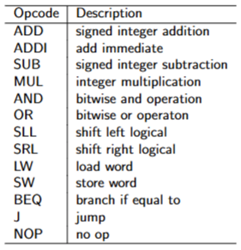
supported MIPS instructions

Slide 4
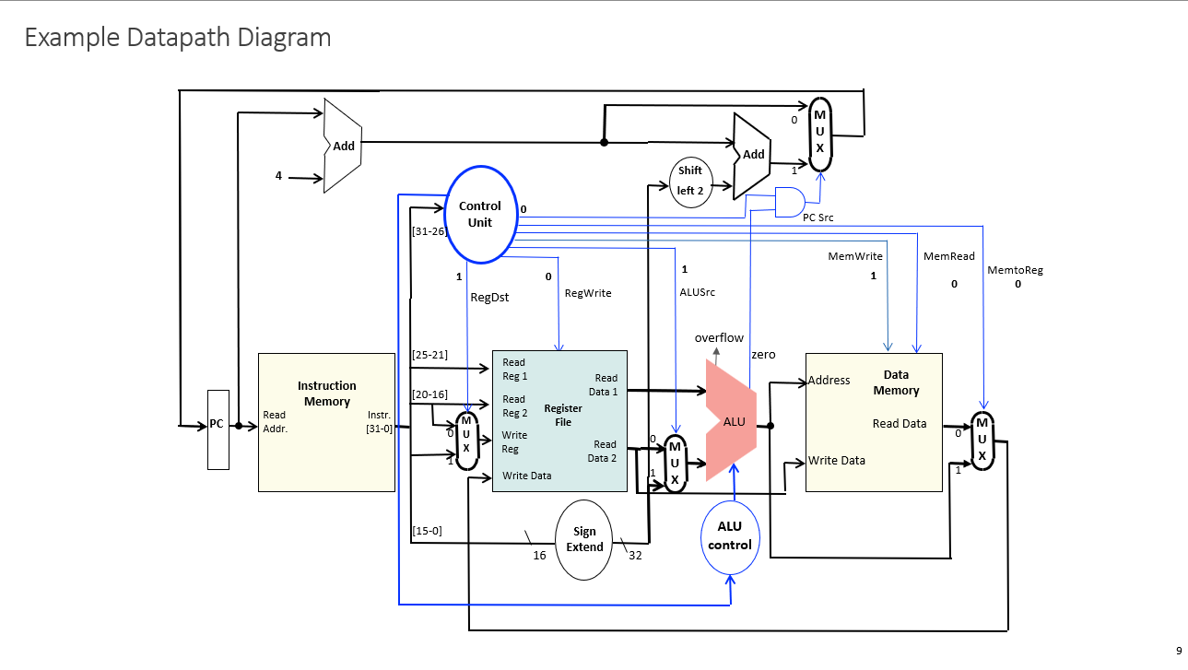
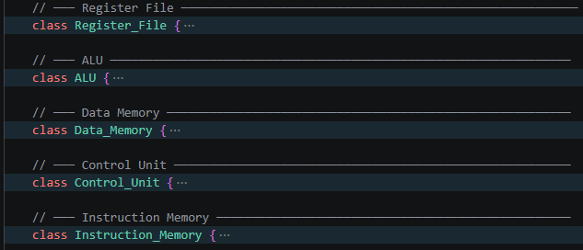
Processor datapath

Slide 5
Microarchitecture
represented as code

Slide 6
5 stage MIPS pipeline
IF
Instruction Fetch: Fetch instruction from memory and update PC
ID
Instruction Decode: Decode instructions and read from register file
EX
Execute: Execute arithmetic instruction, calculate memory address
MEM
Memory (MEM): Read/write data from/to the data memory
WB
Write back: Write result data into the register file

Slide 7
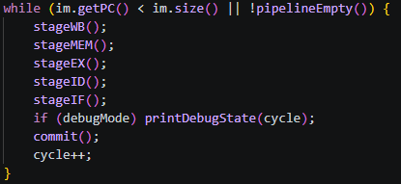


Pipeline design choices
Reverse order
State register duplicates
State register validation
(ex):
Each stage of our pipeline is implemented in reverse order throughout single instruction cycle
This helps state registers avoid overriding each other during execution
For each state register, we include a current and next version of each state register
This helps …
Each state register includes a flag for if data is valid. Only when valid is true, will the state register propagate its instruction to the next
At the end of pipeline cycle commit() is used to update the next version of each state register with the current state register

Slide 8

Program demonstration

Slide 9
Any questions?????
Q&A:

Slide 10
Thank You!

